Slide 1
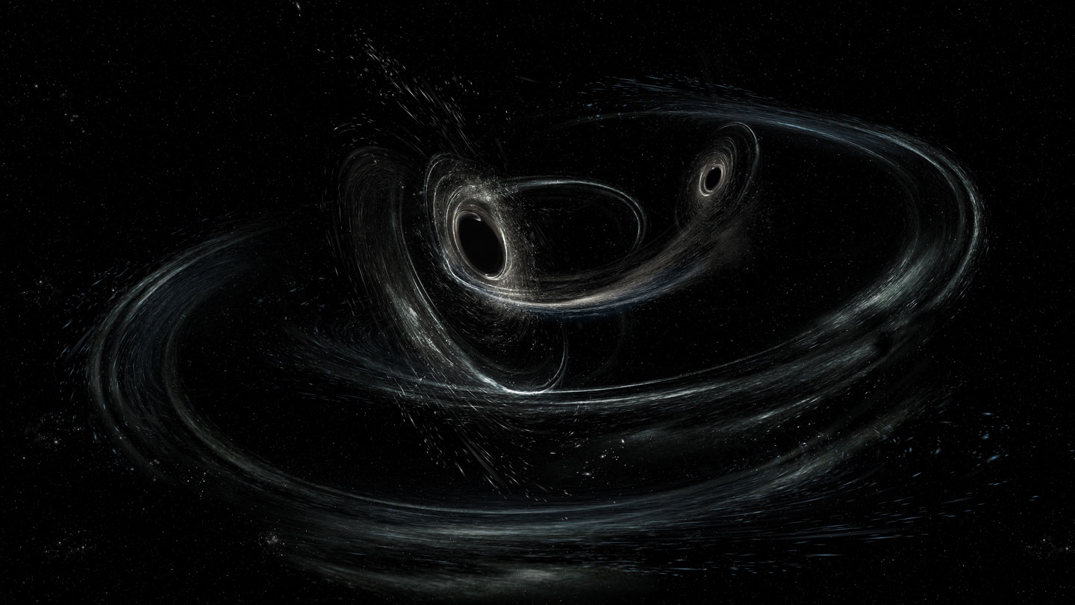


Can We Distinguish Lensing and Precession Effects in Gravitational Wave Signals?
Tamanjyot Singh¹
Tien Nguyen², Benjamin McCallip³, Michael Kesden¹, Lindsay King¹
¹The University of Texas at Dallas, TX;
²Cornell University, Ithaca, NJ; ³Southwestern University, Georgetown, TX
APS Global Physics Summit 2026, Denver, CO
03/18/2026
Image credit: LIGO/Caltech/MIT/Sonoma State (Aurore Simonnet)

Slide 2
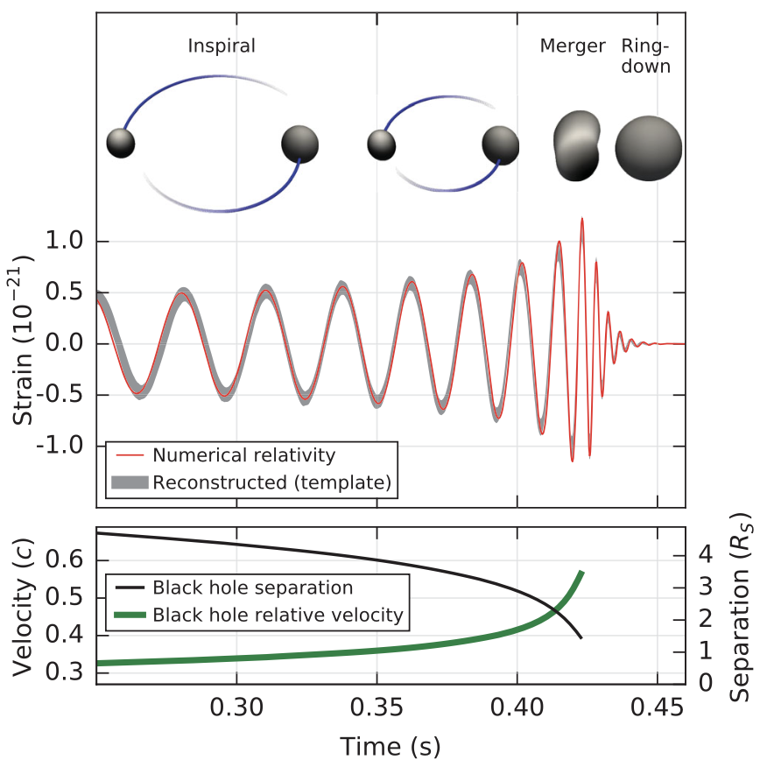
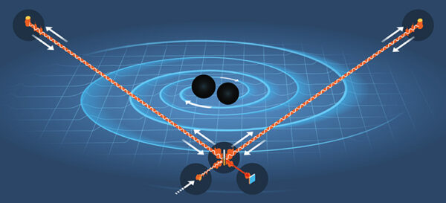
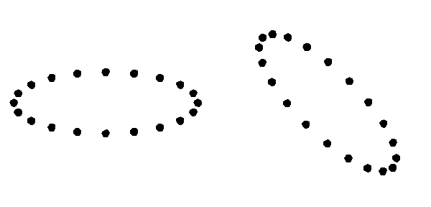
GW Emission
Illustration: Johan Jarnestad
Abbott+ (2016)
GWs emitted by merging (stellar-mass) compact objects are observed by LIGO-Virgo-KAGRA (LVK).
As GWs pass through interferometers, they stretch and squeeze spacetime.
LVK network has observed 218 GW signals in 4 runs (O4b&c results not included).
Wikipedia
03/18/2026

Slide 3
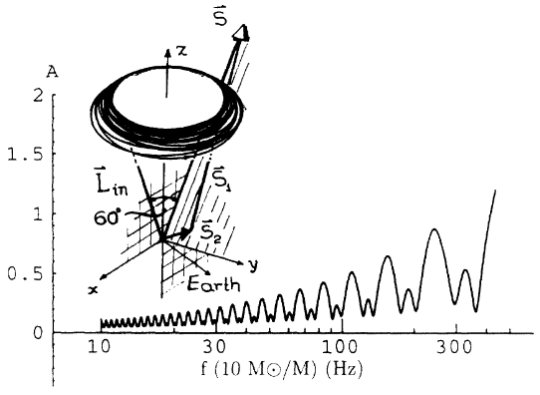
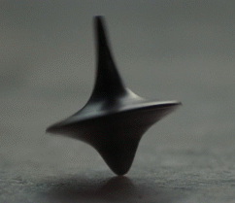
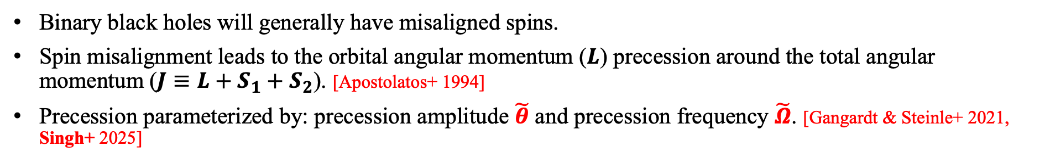

Precession
$$h\left(f\right)=B(f)e^{iΦ(f)}$$
Apostolatos+ (1994)
Adapted from Singh+ 2025
Binary black holes will generally have misaligned spins.
Spin misalignment leads to the orbital angular momentum ($L$) precession around the total angular momentum ($J≡L+S_{1}+S_{2}$). [Apostolatos+ 1994]
Precession parameterized by: precession amplitude $\tilde{θ}$ and precession frequency $\tilde{Ω}$. [Gangardt & Steinle+ 2021, Singh+ 2025]
03/18/2026

Slide 4
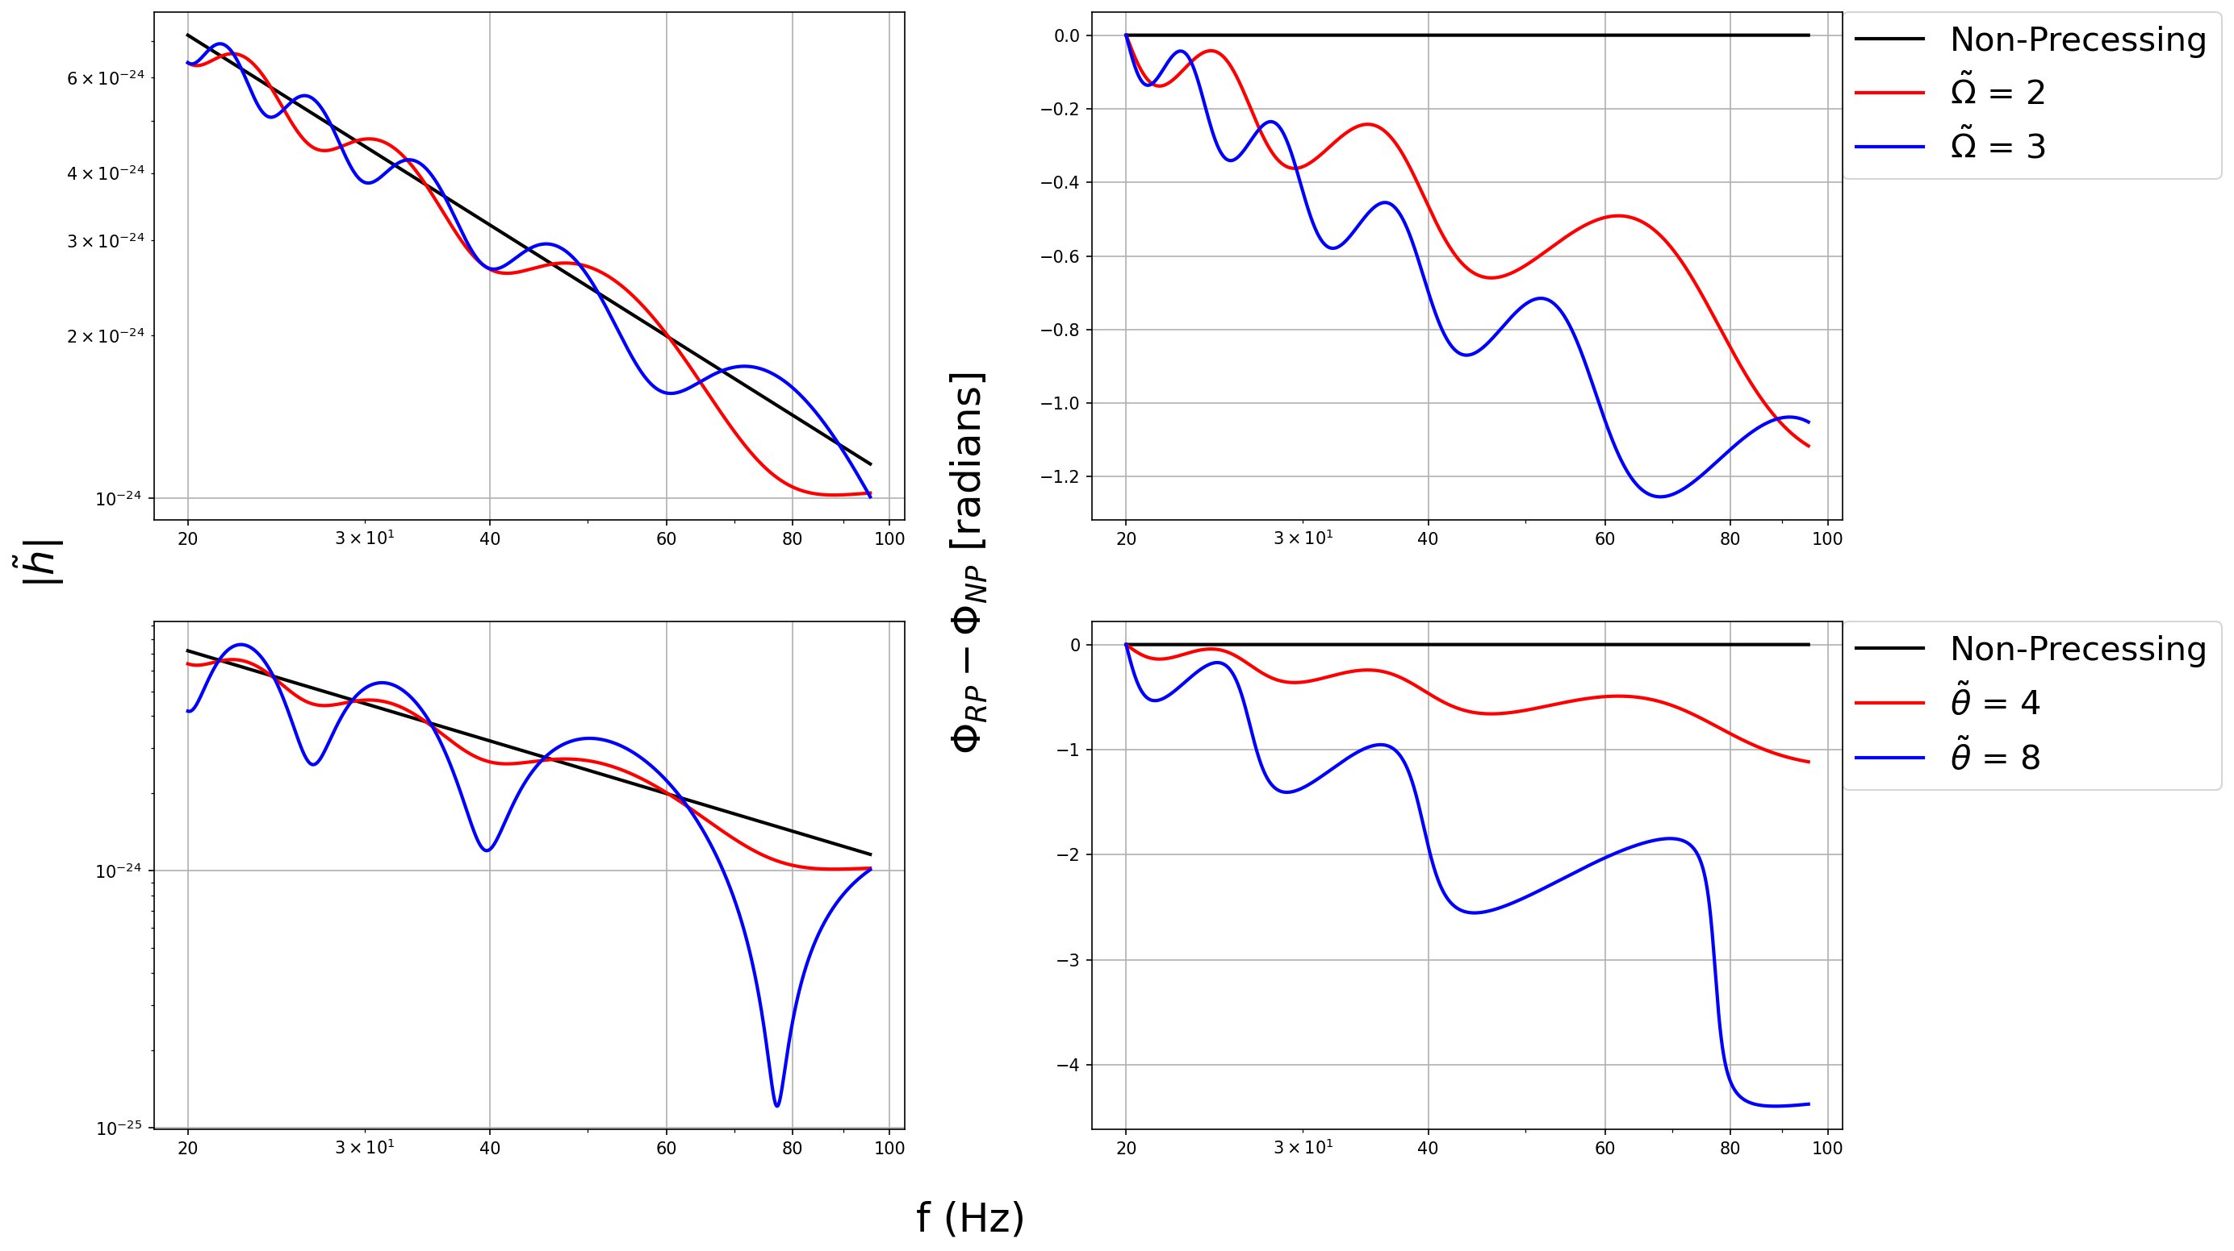
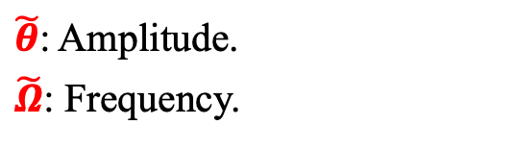



Precessing waveforms
$\tilde{θ}$ = 4
$$h\left(f\right)=B(f)e^{iΦ(f)}$$
$\tilde{Ω}$ = 2
$\tilde{θ}$: Amplitude.
$\tilde{Ω}$: Frequency.
Singh+ (2025)
Edge-on
03/18/2026

Slide 5
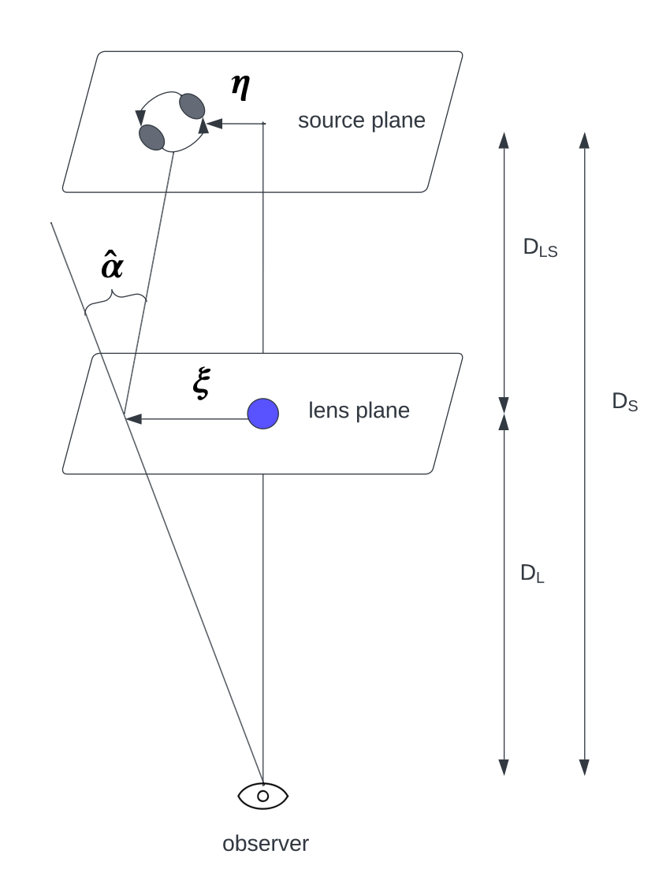
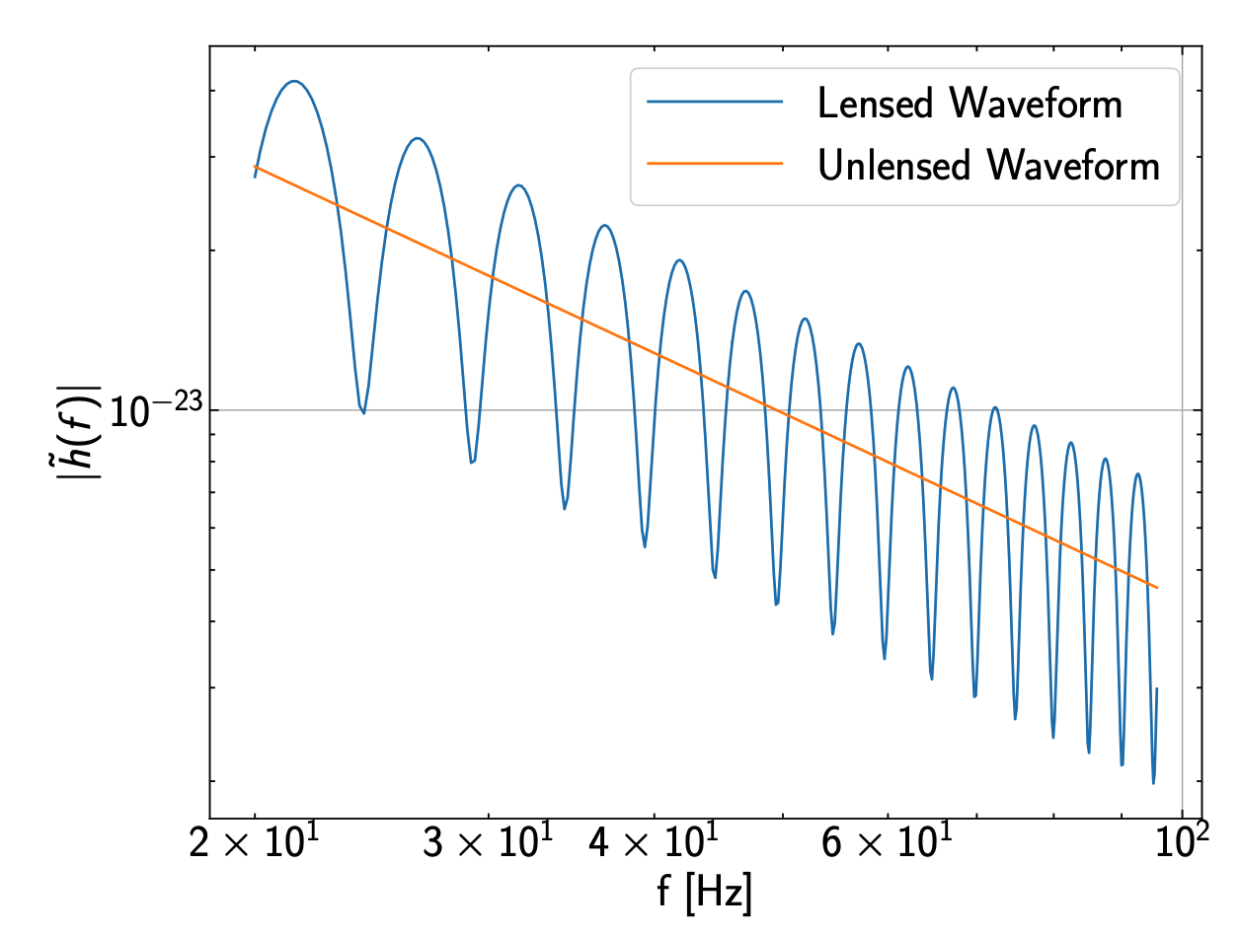
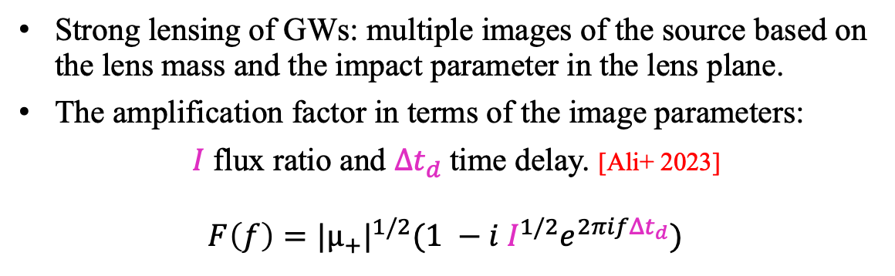

Gravitational lensing
Strong lensing of GWs: multiple images of the source based on the lens mass and the impact parameter in the lens plane.
The amplification factor in terms of the image parameters:
$I$ flux ratio and $Δt_{d}$time delay. [Ali+ 2023]
$$F\left(f\right)={\text{|}{\text{µ}}_{+}\text{|}}^{1/2}(1 −i I^{1/2}e^{2πifΔt_{d}})$$
$$h_{L}\left(f\right)=F(f)h_{UL}(f)$$
Ali+ (2023)
Ali+ (2023)
03/18/2026

Slide 6
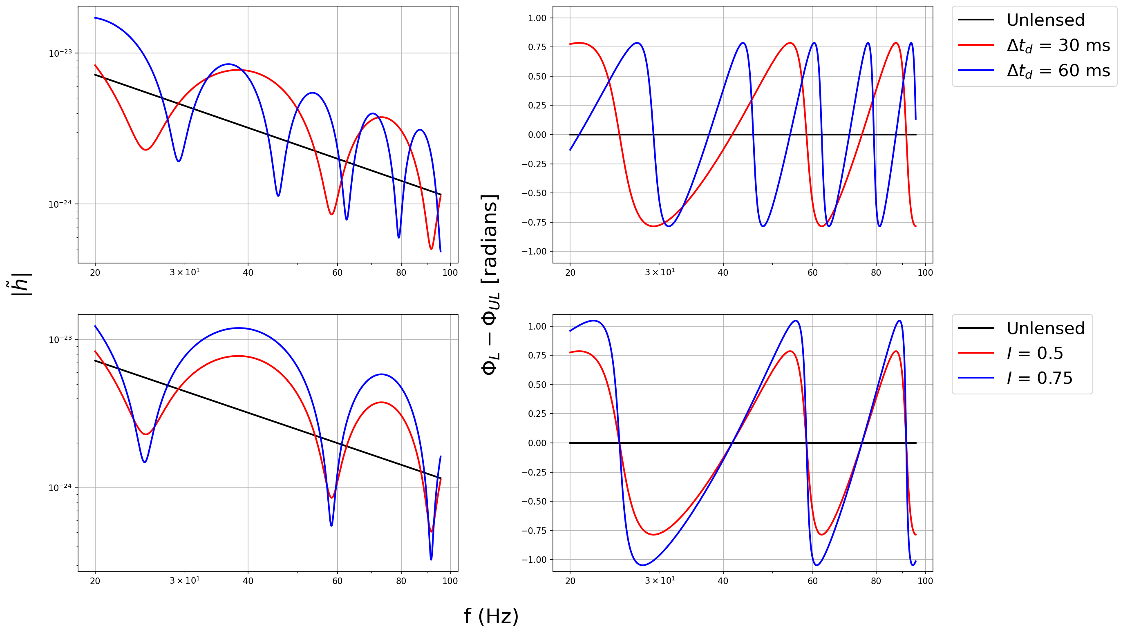
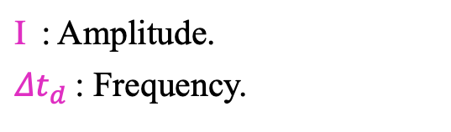


Lensed waveforms
I = 0.5
$$h\left(f\right)=B(f)e^{iΦ(f)}$$
${Δt}_{d}$ = 30 ms
$\text{I}$: Amplitude.
${Δt}_{d}$: Frequency.
Nguyen & Singh+ (in prep)
Edge-on
03/18/2026

Slide 7
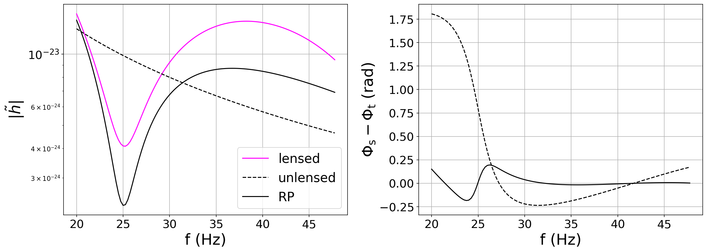



Mismatch
I = 0.5
${Δt}_{d}$ = 30 ms
$ℳ_{c}$ = 40$M_{⊙}$
$$ε\left(h_{s}, h_{t}\right)=1− M\left(h_{s}, h_{t}\right)$$
Mismatches encapsulate differences between the two waveforms, $0≤ε≤1$.
Loss in mismatch for lensed signal when compared to precessing templates.
Nguyen & Singh+ (in prep)
03/18/2026

Slide 8
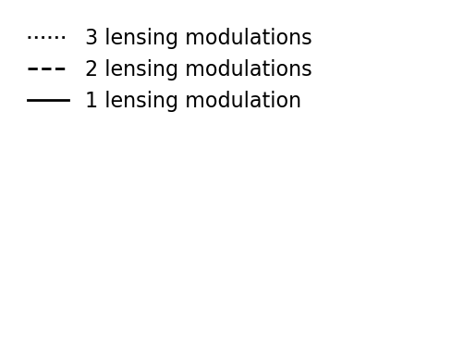
Lensing and Precession: indistinguishable?
I = 0.5
Nguyen & Singh+ (in prep)
Edge-on
Rich degeneracy for < 3 lensing cycles (and shorter waveforms) → Indistinguishable.
> 3 lensing cycles, the characteristic differences in the modulations take over → Distinguishable.
03/18/2026

Slide 9
Summary
Nguyen & Singh+ (in prep)
Precession and lensing both modulate gravitational waveforms.
Precession amplitude and flux ratios of the images affect the amplitude of the modulations
Precession frequency and time delay between the images determine the number of modulations.
Lensing only has an oscillatory phase contribution + the modulation characteristics differ from precession.
With shorter waveforms or less lensing cycles, precession and lensing can be indistinguishable.
Strong lensing is for current observations is exotic, while precession must be generic.
Future detectors (3rd Generation: Cosmic explorer, Einstein Telescope & LISA) will be sensitive to sources further away, increasing the lensing probability.
03/18/2026

Slide 10


Thank you
Acknowledgements
Collaborators: Tien Nguyen, Benjamin McCallip, Dr. Michael Kesden, Dr. Lindsay King
This research is supported by National Science Foundation (NSF) grants PHY-2309320, PHY-2348872, and AST-2219128.
High-performance computing: Texas Advanced Computing Center (TACC)
Personal webpage:
singhtaman.github.io
Contact: tamanjyot@utdallas.edu
10
Image credit: LIGO/Caltech/MIT/Sonoma State (Aurore Simonnet)
Notes:
grants PHY-2011977 and PHY-2309320

Slide 11
Extra Slides
Personal webpage:
singhtaman.github.io
Contact: tamanjyot@utdallas.edu
11
Image credit: LIGO/Caltech/MIT/Sonoma State (Aurore Simonnet)
Notes:
grants PHY-2011977 and PHY-2309320

Slide 12
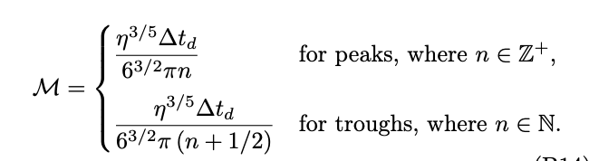

Mismatch peaks/troughs + cycles
Edge-on
Nguyen & Singh+ (in prep)
03/18/2026

Slide 13
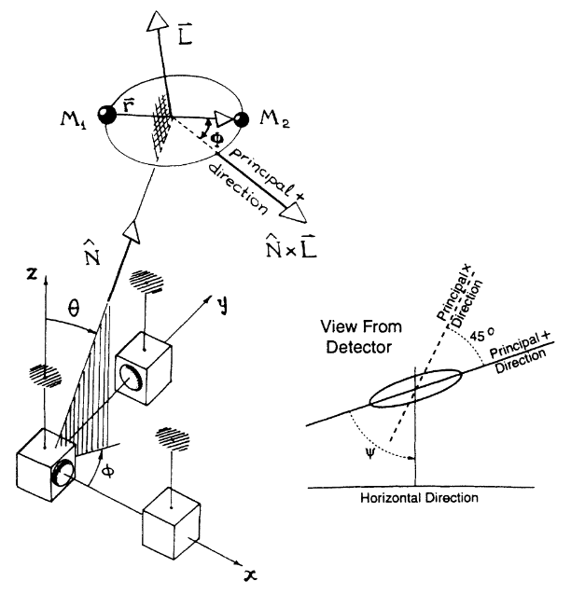



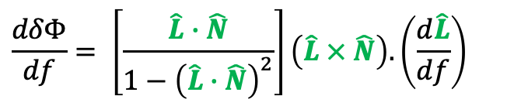

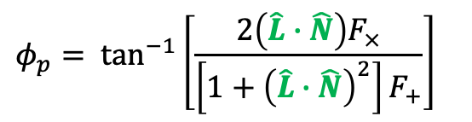
Precessing GW signal
$${\tilde{h}}_{+}\left(f\right)=Af^{−7/6}[1+{(\hat{L}∙\hat{N})}^{2}]e^{iΨ}$$
$${\tilde{h}}_{×}\left(f\right)=−2iAf^{−7/6}(\hat{L}∙\hat{N})e^{iΨ}$$
$$h\left(f\right)=F_{+}h_{+}\left(f\right)+F_{×}h_{×}\left(f\right)$$
$$h\left(f\right)=B(f)e^{iΦ(f)}$$
$$B\left(f\right)=Af^{−7/6}{\left\{4{\left(\hat{L}∙\hat{N}\right)}^{2}{F_{×}}^{2}+{\left[1+{\left(\hat{L}∙\hat{N}\right)}^{2}\right]}^{2}{F_{+}}^{2}\right\}}^{1/2}$$
$$Φ\left(f\right)=Ψ\left(f\right)− φ_{p} −2δΦ$$
$$φ_{p}= \tan^{−1}\left[\frac{2\left(\hat{L}∙\hat{N}\right)F_{×}}{\left[1+{\left(\hat{L}∙\hat{N}\right)}^{2}\right]F_{+}}\right]$$
$$\frac{dδΦ}{df}= \left[\frac{\hat{L}∙\hat{N}}{1−{\left(\hat{L}∙\hat{N}\right)}^{2}}\right]\left(\hat{L} × \hat{N}\right).\left(\frac{d\hat{L}}{df}\right)$$
Apostolatos+ (1994)
03/18/2026

Slide 14
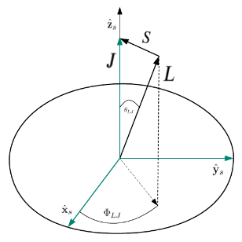
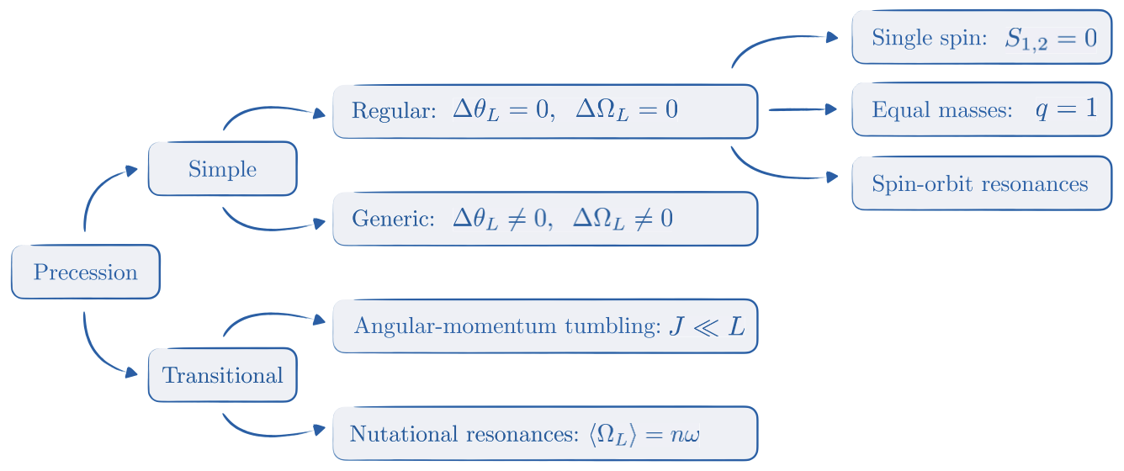
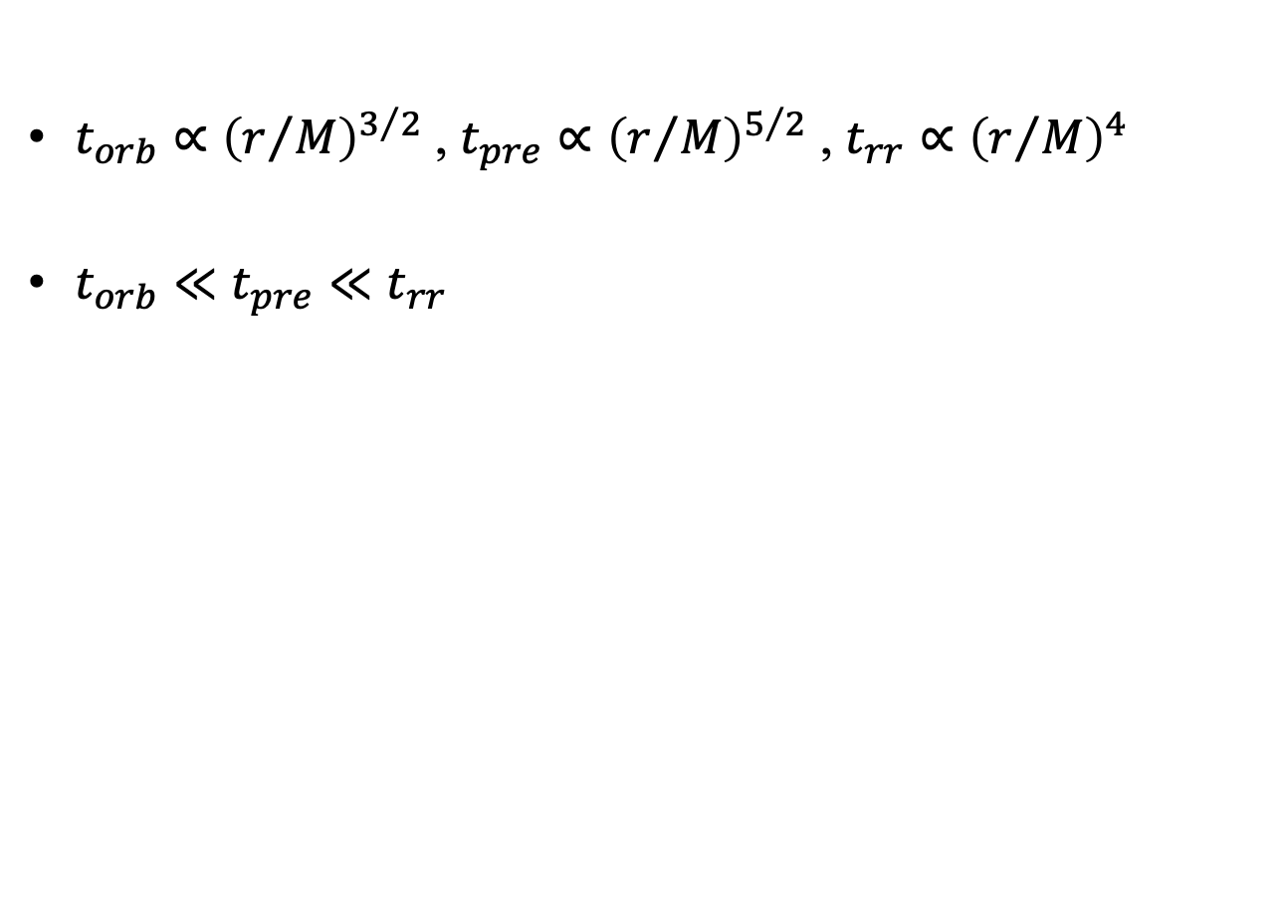
Multi-timescale + Taxonomy
*PN, quasi-circular, inspiral-only waveforms
$t_{orb}∝{\left(r/M\right)}^{3/2}$ , $t_{pre}∝{\left(r/M\right)}^{5/2}$ , $t_{rr}∝{\left(r/M\right)}^{4}$
$t_{orb}≪t_{pre}≪t_{rr}$
Orbital
Precession
Radiation–reaction
Gangardt and Steinle + (2021)
03/18/2026

Slide 15
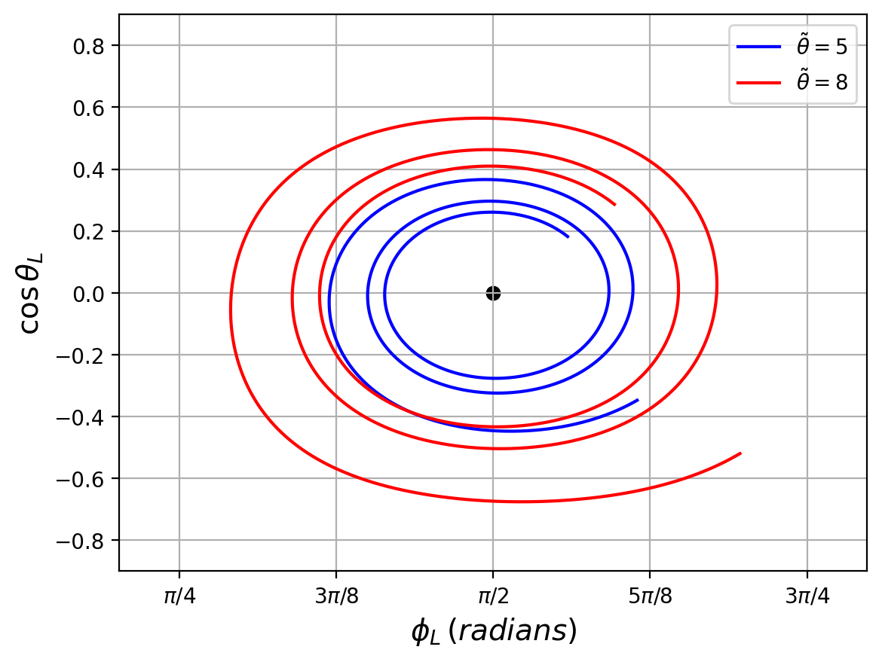
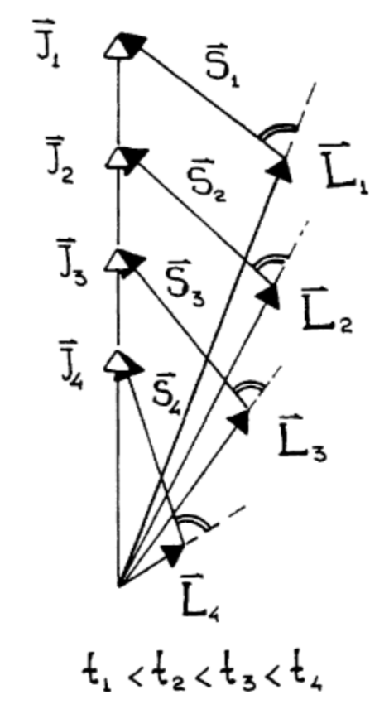
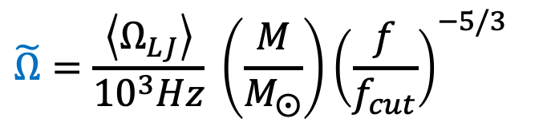
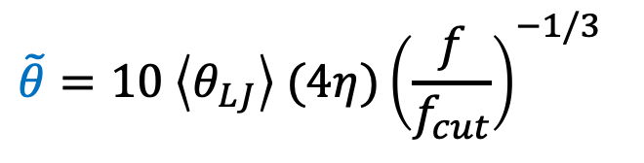
Dimensionless precession parameters – with nutation
$$\tilde{θ}=10 \left\langle θ_{LJ}\right\rangle (4η){\left(\frac{f}{f_{cut}}\right)}^{−1/3}$$
$$\tilde{Ω}=\frac{\left\langle Ω_{LJ}\right\rangle }{{10}^{3}Hz} \left(\frac{M}{M_{⨀}}\right){\left(\frac{f}{f_{cut}}\right)}^{−5/3}$$
Apostolatos+ (1994)
TS+ (2025)
03/18/2026

Slide 16
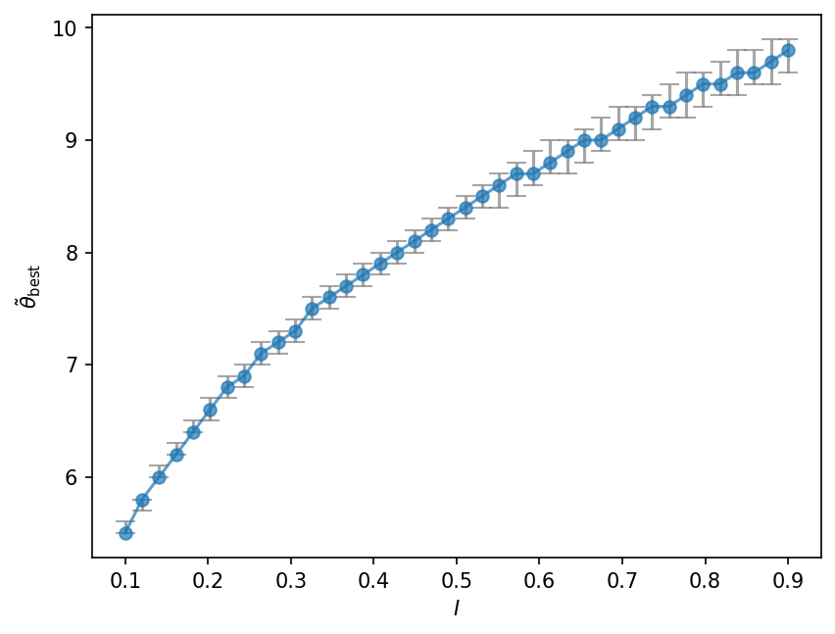
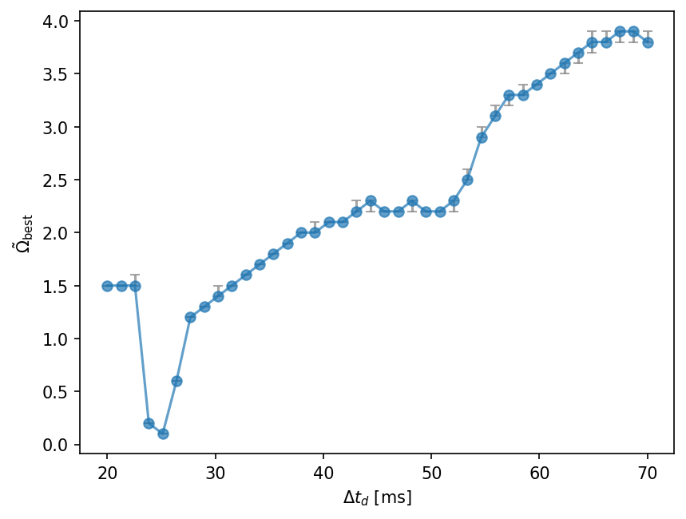


Degeneracy between parameters
Nguyen & Singh+ (in prep)
Edge-on
I ~ 0.5
${Δt}_{d}$ ~ 30 ms
$ℳ_{c}$ = 40$M_{⊙}$
03/18/2026

Slide 17
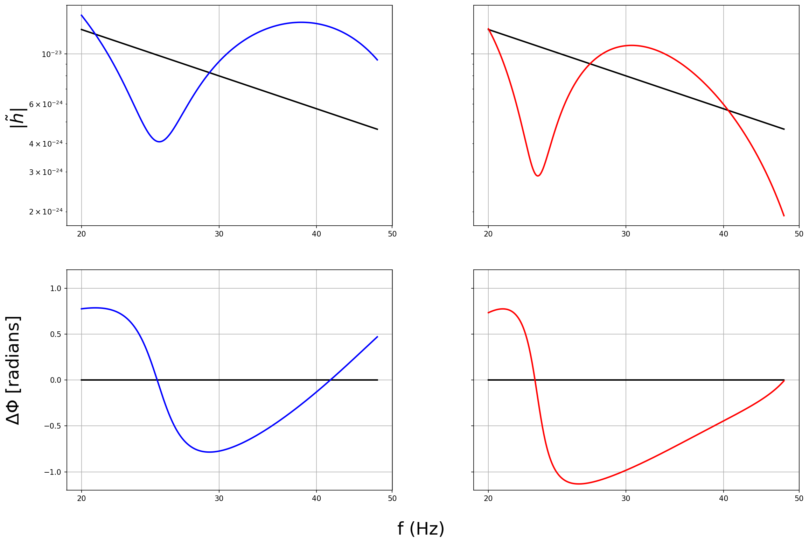
Waveforms
Nguyen & Singh+ (in prep)
Edge-on
03/18/2026

